Slide 1
ENDNOTE FOR SCIENCE AND ENGINEERING
JAMES SODERMAN

Slide 2
Where are you now with Endnote?
Go to www.govote.at
Use the code 97 67 79

Slide 3
Learning outcomes
After this session you will know how to:
Set up a new Endnote library
Manage your references
Incorporate your references into Word documents
Create different types of bibliographies
Import PDFs
Sync your desktop version with your online version/app

Slide 4
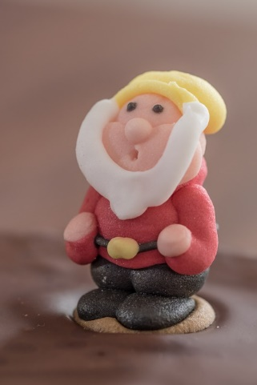
Which version to use?

Slide 5
http://goo.gl/eRJHVA

Slide 6
- Online and App-version - Large number of citation styles
- To get the full product on your personal computer you need to pay - Not compatible with Linux

Slide 7
- Possible to collaborate with other people
- Social networking
- Iphone/Ipad interface
- Limited free storage space
- Desktop application does not sync automatically with the online version.

Slide 8
- Iphone/Ipad interface - Simple Firefox plugin - Makes it easier to reference website
- Limited free storage space

