Slide 1
Alternative Cessation Methods to Electronic Cigarettes
Lojain Jamal, Reman Al Abdulaaly, Rawan Al Shahoomi, Ahmed Abdulrahman , Mobarak Al Hasam

Slide 2
Table of Contents
Nicotine replacement therapy (NRT)
Nicotine gum
Nicotine patches
Varenicline (Champix)
Bupropion ( Zyban)
Evaluation
References

Slide 3
Nicotine replacement therapy (NRT)
NRT is a medication that provides the smoker with nicotine at decreased levels without the poisonous substances found in cigarettes such as tar and carbon monoxide.
It aids in reducing the withdrawal effects, including cravings and bad moods, that would normally occur when quitting smoking.
NRT comes in various forms:
Nicotine gum
Patches
Inhalators
Tablets
Sprays (NHS, 2018)
(Tobacco-Free Life, 2018)

Slide 4
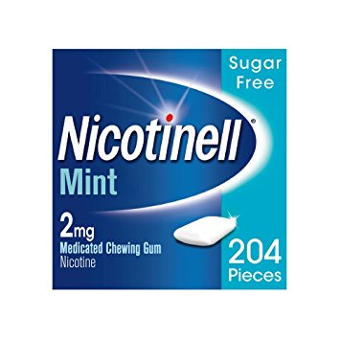
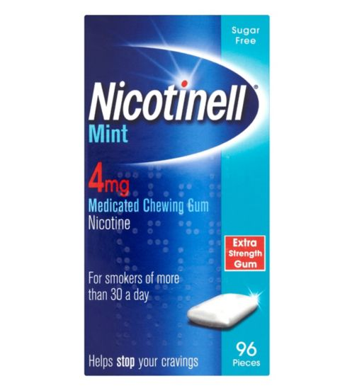
Nicotine gum
How it works:
Two strengths are available - 2 mg and 4 mg.
15 pieces of gum are chewed a day to begin with and will decrease gradually.
Side effects:
Increased heart rate, oral irritation, dental pain, nausea, indigestion.
Cost:
£13.00 for 96 pieces of nicotine gum. (Boots, 2018)
Evaluation of method:
Main disadvantage of gum is that some people do not like constantly having something in their mouth or may not like the taste. Also, gum is not suitable if you wear dentures.
7% success rate after one year.
(Nicotinell, 2018)
(Nicotinell, 2018)

Slide 5
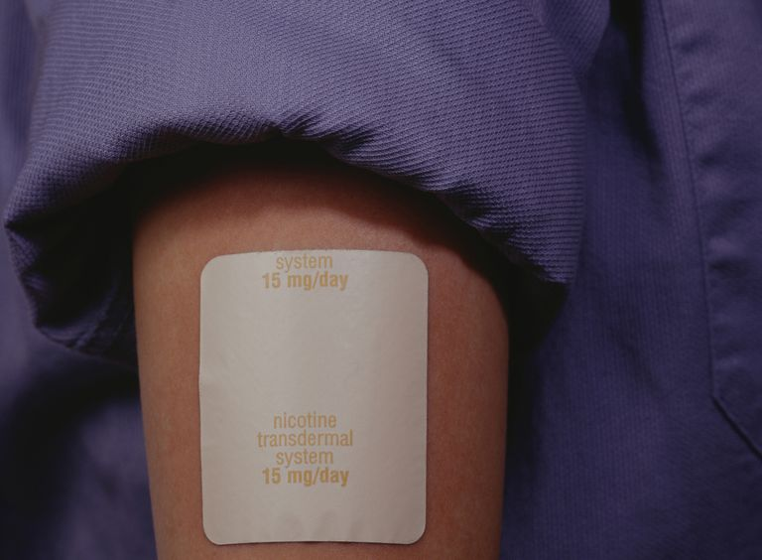
Nicotine patches
How it works:
A patch that is stuck on to the skin releases nicotine into the bloodstream.
Gradually reduce the strength of the patch over time before stopping completely.
Side effects:
Skin irritation, itching, dizziness, nausea.
Cost:
£8.66 for seven nicotine patches. (The Balance, 2018)
Evaluation of method:
Main disadvantage is that a steady amount of nicotine is delivered. This does not mimic the alternate high and low levels of nicotine when you smoke, or with chewing nicotine gum and skin irritation beneath the patch occurs in some users.
8.2% success rate after 6 months.
(The Balance, 2018)

Slide 6
Varenicline (Champix)
How it works:
Reduces craving for cigarettes
Start taking it one or two weeks before you stop smoking
Prescription only treatment that lasts for 12 weeks (1 mg twice daily)
Unavailable for pregnant women (NHS, 2018)
Side effects:
Difficulty concentrating, sleep disturbance, fatigue.
Cost:
4 weeks starter pack costs £81 (lloydspharmacy, 2018)
Evaluation of method:
53.1% success rate after one year.
(Champix, 2018)

Slide 7
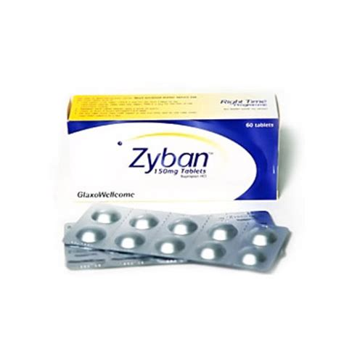
Bupropion (Zyban)
How it works:
Affects brain to minimize withdrawal cravings
Prescription required with course consisting of two tablets per day up to 9 weeks.
Side effects:
Dry mouth, insomnia, headaches, constipation, dizziness. (NHS, 2018
Cost:
£120 for 120 tablets
Evaluation of method:
Safe for most people.*
30% success rate after one year.
(Zyban, 2018)

Slide 8
Overall Evaluation
A combination of two forms of NRT have a higher success rate than using a single one.
A study was conducted on smokers using nicotine inhalar and patch. The success rate of those using the combination was 60.5% and those using only inhaler had a success rate of 47.5%. After a year, 19.5% using the combination remained smoke free while only 14% of those who used the inhaler only remained smoke free.
A combination of Zyban and NRT had a higher success rate of 39% after one year.
Champix more commonly prescribed over Zyban due to higher success rates.

Slide 9
References:
Amazon (2018). Nicotinell Nicotine Gum, Stop Smoking Aid (2 mg, Mint, 204-Piece). [online] Available at: https://www.amazon.co.uk/Nicotinell-Nicotine-Stop-Smoking-204-Piece/dp/B0033AT3HU [Accessed 4 Feb. 2018].
Boots (2018). Gum | Smoking Control - Boots. [online] Available at: http://www.boots.com/health-pharmacy/lifestyle-wellbeing/stopsmoking/gum [Accessed 4 Feb. 2018].
Generico. (2018). Comprar Viagra sin receta barata online España: Cialis y Levitra genérico.. [online] Available at: http://generico-farmacia-enlinea.com/en/drugs/zyban-generic [Accessed 3 Feb. 2018].
lloydspharmacy (2018). Champix Tablets | LloydsPharmacy Online Doctor UK. [online] Available at: https://onlinedoctor.lloydspharmacy.com/uk/stop-smoking/champix [Accessed 4 Feb. 2018].
NHS (2018). Stop smoking treatments. [online] Available at: https://www.nhs.uk/conditions/stop-smoking-treatments/#bupropion-zyban [Accessed 3 Feb. 2018].
NHS (2018). Stop smoking treatments. [online] Available at: https://www.nhs.uk/conditions/stop-smoking-treatments/#nicotine-replacement-therapy-nrt [Accessed 4 Feb. 2018].
NHS (2018). Stop smoking treatments. [online] Available at: https://www.nhs.uk/conditions/stop-smoking-treatments/#varenicline-champix [Accessed 4 Feb. 2018].
The Balance. (2018). Find Coupons for Nicotine Patches and Other Aids to Quit Smoking. [online] Available at: https://www.thebalance.com/nicotine-patch-coupons-940008 [Accessed 4 Feb. 2018].
Tobacco-Free Life. (2018). Nicotine Replacement Therapy — Quit Smoking with NRT. [online] Available at: https://tobaccofreelife.org/quit-smoking/quit-smoking-methods/nicotine-replacement-therapy/ [Accessed 4 Feb. 2018].

